Slide 1


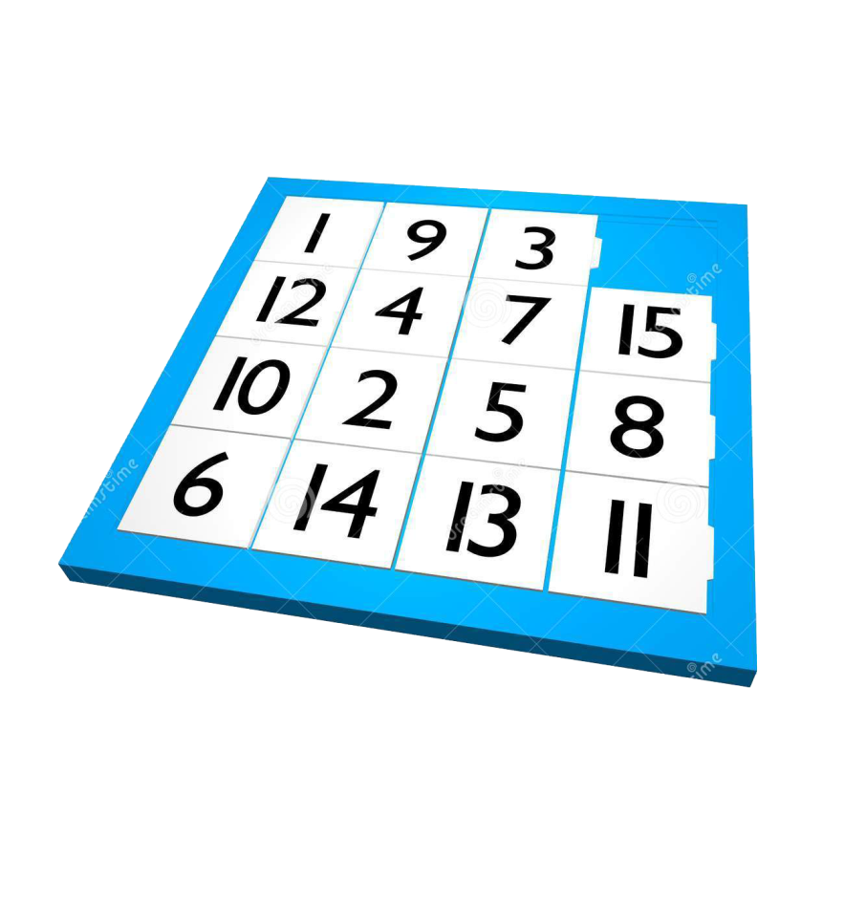
Team: “Game Fifteen 5”
Teamwork - High Quality Programming Code
Telerik Software Academy
Learning & Development
http://academy.telerik.com

Slide 2


Introduction
Game “Fifteen” is a sliding puzzle, where the player tries to arrange the numbers from 1 to 15 sequentially in a square matrix of size 4 x 4. The game starts from a randomly shuffled 15 numbers in a matrix (4 x 4) and a random cell left empty. The game finishes when the numbers are arranged sequentially.
Game start:
Game finish:

Slide 3
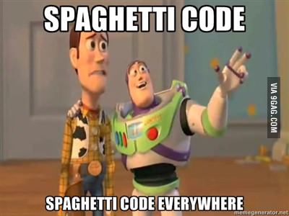
In The Beginning…
…there was…
Only one class with 342 lines of “HQ” programing code
Some name on Cyrillic and Maymunica. The best were GenerateТаблица and топКандидати
Magic numbers and strings everywhere
No non-static methods, fields or properties
And so on…

Slide 4
Statistics After Refactoring
From one file we created:
More than 100 classes, interfaces and enums.
5 projects + 3 additional (unit tests & another UI)
10 design patterns
Reusable libraries and classes/interfaces
High level abstraction
85 unit tests with code coverage of 85.62%

Slide 5
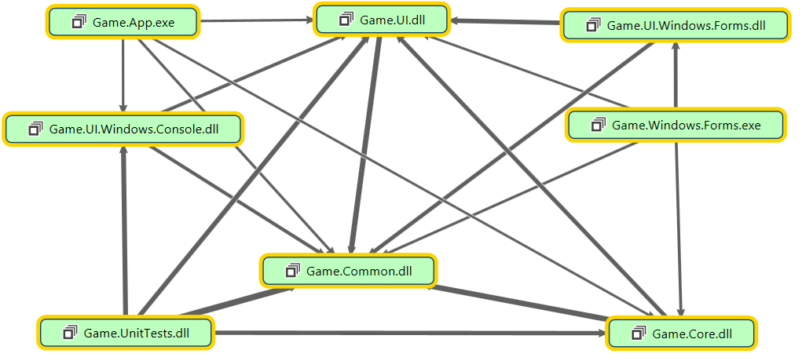
Code Map
Game Fifteen

Slide 6
Creational Patterns
Singleton
Game.Common.Stats.InFileScores.cs
Game.Common.Stats.InMemoryScores.cs
Game.Common.Utils.DefaultRandomGenerator.cs
Prototype
Game.Common.Position.cs
Game.Common.Clonable.cs

Slide 7
Structural Patterns
Flyweight
Game.Common.ActionType.cs
Game.Core.Actions.ActionProviders.ActionProvider.cs
Decorator
Game.Common.Map.Decorators.MoveableField.cs
BridgeGame.Core.GameEngine.cs

Slide 8
Behavioural Patterns
Command
Game.Core.Actions.ActionReceiver.DefaultActionReceiver
Strategy
Game.Common.Map.Field.cs
Game.UI.IOProviders.IOProvider.cs
Iterator
Game.Common.Map.Field.cs
Observer
Game.Core.GameEngine.cs
Template Method
Game.Core.Actions.ActionProviders.ActionProvider.cs
Game.UI.IOProviders.IOProvider.cs
Game.Common.Map.Movement.Movement.cs

Slide 9
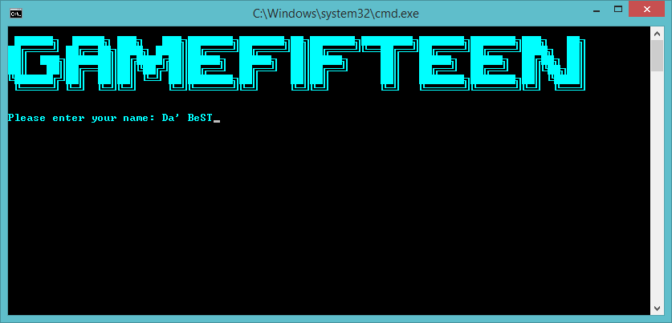

Game Fifteen
Demo

Slide 10
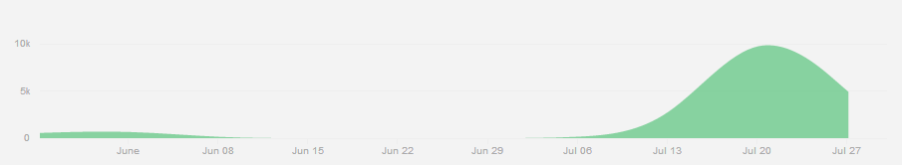
Github Repository
https://github.com/TeamGameFifteen-5/GameFifteen
112 commits
Development lifetime – not in the “last minute”.

Slide 11
Defensive Programming
http://academy.telerik.com

